Slide 1
Writing Basic SQL Statements
Course Code: CSC 2108
Course Title: Introduction To Database
Department of Computer Science
Faculty of Science and Technology
Lecture No: | 02 | Week No: | 01 | Semester: | Summer 23-24
Lecturer: | Nazia Alfaz, nazia@aiub.edu

Slide 2
Lecture Outline
The capabilities of SQL SELECT statements
The execution of a basic SELECT statement
The Difference between SQL statements and SQL*Plus commands

Slide 3
Capabilities of SQL SELECT Statements
Selection, Projection, Join
Selection
Projection
Table 1
Table 1
Join
Table 1
Table 2

Slide 4
Basic SELECT Statement
SELECT [DISTINCT] {*, column [alias],...}
FROM table;
  SELECT identifies what columns.
  FROM identifies which table.

Slide 5
Writing SQL Statements
  SQL statements are not case sensitive.
  SQL statements can be on one or
  more lines.
  Keywords cannot be abbreviated or split across lines.
  Clauses are usually placed on separate lines.

Slide 6
Selecting All Columns
SQL> SELECT *
2 FROM dept;
DEPTNO DNAME LOC
--------- -------------- -------------
10 ACCOUNTING NEW YORK
20 RESEARCH DALLAS
30 SALES CHICAGO
40 OPERATIONS BOSTON

Slide 7
Selecting Specific Columns
SQL> SELECT deptno, loc
2 FROM dept;
DEPTNO LOC
--------- -------------
10 NEW YORK
20 DALLAS
30 CHICAGO
40 BOSTON

Slide 8
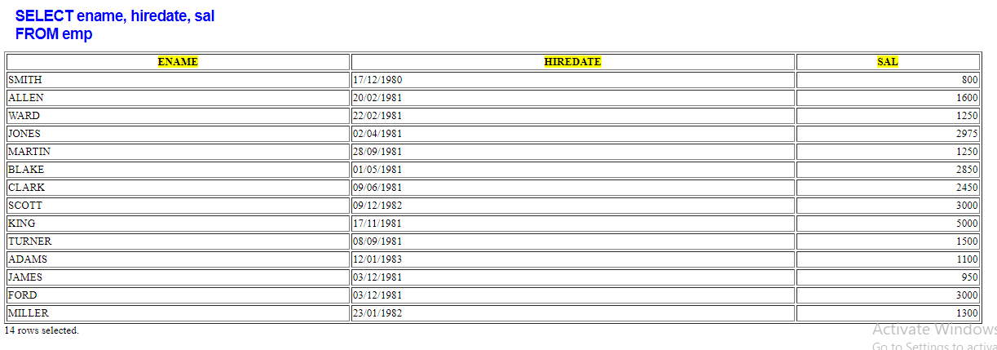
Column Heading Defaults
  Default justification
    Left: Date and character data
    Right: Numeric data
  Default display
  Uppercase

Slide 9
Arithmetic Expressions
Create expressions on NUMBER and DATE data by using arithmetic operators.
Operator | Description
+ | Add
- | Subtract
* | Multiply
/ | Divide

Slide 10
Using Arithmetic Operators
SQL> SELECT ename, sal, sal+300
2 FROM emp;
ENAME SAL SAL+300
---------- --------- ---------
KING 5000 5300
BLAKE 2850 3150
CLARK 2450 2750
JONES 2975 3275
MARTIN 1250 1550
ALLEN 1600 1900
...
14 rows selected.

Slide 11
Operator Precedence
_
*
/
+
  Multiplication and division take priority over addition and subtraction.
  Operators of the same priority are evaluated from left to right.
  Parentheses are used to force prioritized evaluation and to clarify statements.

Slide 12
Operator Precedence
SQL> SELECT ename, sal, 12*sal+100
2 FROM emp;
ENAME SAL 12*SAL+100
---------- --------- ----------
KING 5000 60100
BLAKE 2850 34300
CLARK 2450 29500
JONES 2975 35800
MARTIN 1250 15100
ALLEN 1600 19300
...
14 rows selected.

Slide 13
Using Parentheses
SQL> SELECT ename, sal, 12*(sal+100)
2 FROM emp;
ENAME SAL 12*(SAL+100)
---------- --------- -----------
KING 5000 61200
BLAKE 2850 35400
CLARK 2450 30600
JONES 2975 36900
MARTIN 1250 16200
...
14 rows selected.

Slide 14
Defining a Null Value
  A null is a value that is unavailable, unassigned, unknown, or inapplicable.
  A null is not the same as zero or a blank space.
SQL> SELECT ename, job, comm
2 FROM emp;
ENAME JOB COMM
---------- --------- ---------
KING PRESIDENT
BLAKE MANAGER
...
TURNER SALESMAN 0
...
14 rows selected.

Slide 15
Null Values in Arithmetic Expressions
Arithmetic expressions containing a null value evaluate to null.
SQL> select ename, 12*sal+comm
2 from emp
3 WHERE ename='KING';
ENAME 12*SAL+COMM
---------- -----------
KING

Slide 16
Defining a Column Alias
  Renames a column heading
  Is useful with calculations
  Immediately follows column name; optional AS keyword between column name and alias
  Requires double quotation marks if it contains spaces or special characters or is case sensitive

Slide 17
Using Column Aliases
SQL> SELECT ename AS name, sal salary
2 FROM emp;
NAME SALARY
------------- ---------
...
SQL> SELECT ename "Name",
2 sal*12 "Annual Salary"
3 FROM emp;
Name Annual Salary
------------- -------------
...

Slide 18
Concatenation Operator
  Concatenates columns or character strings to other columns
  Is represented by two vertical bars (||)
  Creates a resultant column that is a character expression

Slide 19
Using the Concatenation Operator
SQL> SELECT ename||job AS "Employees"
2 FROM emp;
Employees
-------------------
KINGPRESIDENT
BLAKEMANAGER
CLARKMANAGER
JONESMANAGER
MARTINSALESMAN
ALLENSALESMAN
...
14 rows selected.

Slide 20
Literal Character Strings
  A literal is a character, expression or number included in the SELECT list.
  Date and character literal values must be enclosed within single quotation marks.
  Each character string is output once for each row returned.

Slide 21
Using Literal Character Strings
SQL> SELECT ename ||' '||'is a'||' '||job
2 AS "Employee Details"
3 FROM emp;
Employee Details
-------------------------
KING is a PRESIDENT
BLAKE is a MANAGER
CLARK is a MANAGER
JONES is a MANAGER
MARTIN is a SALESMAN
...
14 rows selected.

Slide 22
Duplicate Rows
The default display of queries is all rows, including duplicate rows.
SQL> SELECT deptno
2 FROM emp;
DEPTNO
---------
10
30
10
20
...
14 rows selected.

Slide 23
Eliminating Duplicate Rows
Eliminate duplicate rows by using the DISTINCT keyword in the SELECT clause.
SQL> SELECT DISTINCT deptno
2 FROM emp;
DEPTNO
---------
10
20
30

Slide 24
SQL
SQL
  -> SQL is a command language for communication with the Oracle Server.
Features of SQL
-> Can be used by a range of users, including those with little or no programming experience
-> Is an English-like language

Slide 25
Books
Modern Database Management (Sixth Edition) by Fred R. McFadden, Jeffrey A. Hoffer, Mary B. Prescott
Database System Concepts (Fifth Edition) by Henry F. Korth, S. Sudarshan, A. Silberschatz
Oracle-database-10g-sql-fundamentals-1-student-guide-volume-1
SQL and Relational Theory: How to Write Accurate SQL Code by C.J. Date
Database Systems: A Practical Approach to Design, Implementation and Management (4th Edition) by Thomas M. Connolly, Carolyn E. Begg
Fundamentals of Database Systems, 5th Edition by RamezElmasri, Shamkant B. Navathe
Database Design and Relational Theory: Normal Forms and All That Jazz by C. J. Date
An Introduction to Database Systems 8th Edition, by C.J. Date

Slide 26
References
https://www.db-book.com/db6/slide-dir/index.html
https://docs.oracle.com/en/database/oracle/oracle-database/20/sqlrf/SQL-Standards.html#GUID-BCCCFF75-D2A4-43AD-8CAF-C3C97D92AC63
https://www.slideshare.net/HaaMeemMohiyuddin1/data-knowledge-and-information
https://www.slideshare.net/tabinhasan/from-data-to-wisdom
https://www.slideshare.net/thinnaphat.bo/

